Slide 1
Shenzen Mactech Electronics Co., Ltd.
SMT SOLUTIONS
JUKI Electronic FEEDER Evaluation Report

Slide 2
JUKI Electronic FEEDER Evaluation Report
Efficiency Comparison with MT Juki Electronic Feeder
Pick up Rate Comparison with MT Juki Electronic Feeder
Picture Comparison between MT Electronic and Mechanical Feeder
Feeder Calibration Comparison

Slide 3
1. Efficiency： Tested in 4 machines, each analyzed with Single PCB and Double PCB Panel production. The following are comparisons between Original Mechanical Feeder and MT Electronic Feeder; efficiency can be increased by 22.47% with MT Electronic feeder in Double PCB Panelization production.
Machine Type | Pick-up Rate For 1PCB 2H | Pick-up Rate For Double PCB Panelization 2H | Double PCB Panelization efficiency of pick up (%) | Pick-up rate by Double PCB Panelization and MT Electronic Feeder | Improved Efficiency by Double PCB Panelization and MT Electronic Feeder (%)
A | 39983 | 54580 | 36.51% | 67840 | 24.29%
B | 14400 | 31052 | 115.64% | 39576 | 27.45%
C | 34928 | 69120 | 97.89% | 84521 | 22.28%
B | 34800 | 66071 | 89.86% | 76549 | 15.86%
 |  |  |  | Efficiency Improved： | 22.47%

Slide 4
2. Pick-up Rate Error
Export data from 4 production machine. Average pick up error by MT Juki Electronic Feeder is 0.47%, while average pick up error for Original Mechanical Feeder is 3.6%. Pick-up rate error drops down by 0.3% using MT Electronic feeder.
Pick up error rate using MT Juki Electronic Feeder
Machine | Pick-up Attempts | Pick-up Rate | Component Mounted | Pick-up error | Pick-up rate (%) | Pick-up error Rate (%)
A | 627903 | 627705 | 626806 | 198 | 99.969 | 0.031
B | 113605 | 113571 | 113406 | 34 | 99.978 | 0.022
C | 326648 | 326281 | 325358 | 367 | 99.887 | 0.113
D | 169483 | 169402 | 169216 | 81 | 99.95 | 0.023
 |  |  |  |  | Average Pick-up Error Rate： | 0.04725
Pick up error rate using original mechanical Feeder
Machine | Pick up Attempts | Pick Up Rate | Component Mounted | Pick up error | Pick up rate (%) | Pick up error Rate (%)
A |  | 456974 | 456785 | 189 | 99.619 | 0.381
B |  | 357548 | 357347 | 201 | 99.667 | 0.333
C |  | 324876 | 324712 | 164 | 99.695 | 0.305
D |  | 293356 | 293223 | 133 | 99.582 | 0.418
 |  |  |  |  | Average Pick-up Error Rate： | 0.359

Slide 5
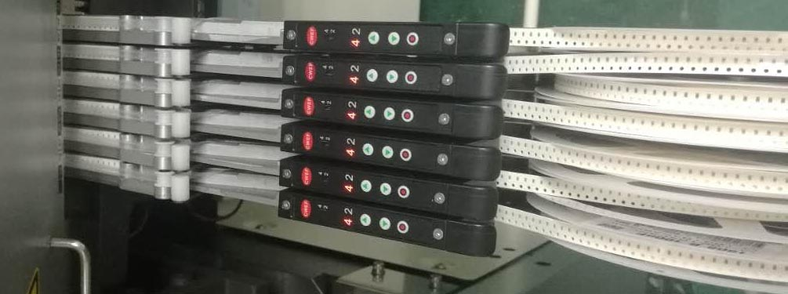
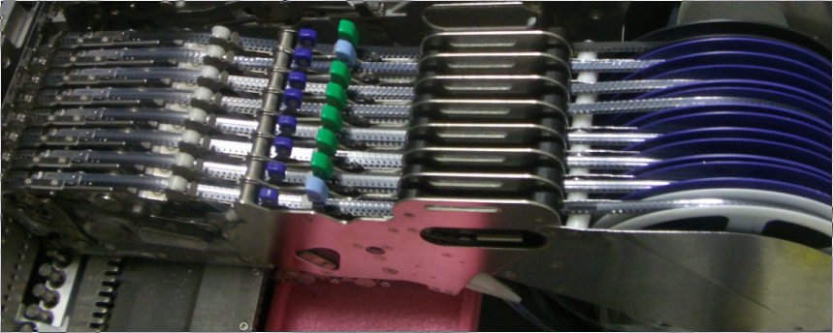
Electronic Feeder
Mechanical Feeder

